Slide 1

Oro e Digital Gold nello scenario di svalutazione delle valute fiat: evidenze e prospettive per l’asset allocation dei grandi patrimoni familiari
6 Ottobre 2025

Slide 2
History & Sociology
Macro & Geopolitics
Finance and scarcity
Agenda

Slide 3

Ouverture
“ Crisis is the greatest blessing for people and nations, because crisis brings progress. Creativity is born from anguish as the day is born from the dark night. It is in the crisis that inventiveness, discoveries and great strategies arise. Whoever overcomes the crisis overcomes himself without being 'overcome'. Those who attribute their failures and difficulties to the crisis violate their own talent and give more value to problems than to solutions. The real crisis is the crisis of incompetence. The drawback of people and nations is the laziness in looking for solutions and ways out. Without crises there are no challenges, without challenges life is a routine, a slow agony. Without crisis there is no merit. It is in crisis that the best of everyone emerges, because without crisis all winds are just light breezes. Talking about a crisis means increasing it, and remaining silent in the crisis means exalting conformism. Instead, let's work hard. Let's put an end to the only dangerous crisis once and for all, which is the tragedy of not wanting to fight to overcome it “
Albert Einstein

Slide 4
History and Sociology

Slide 5
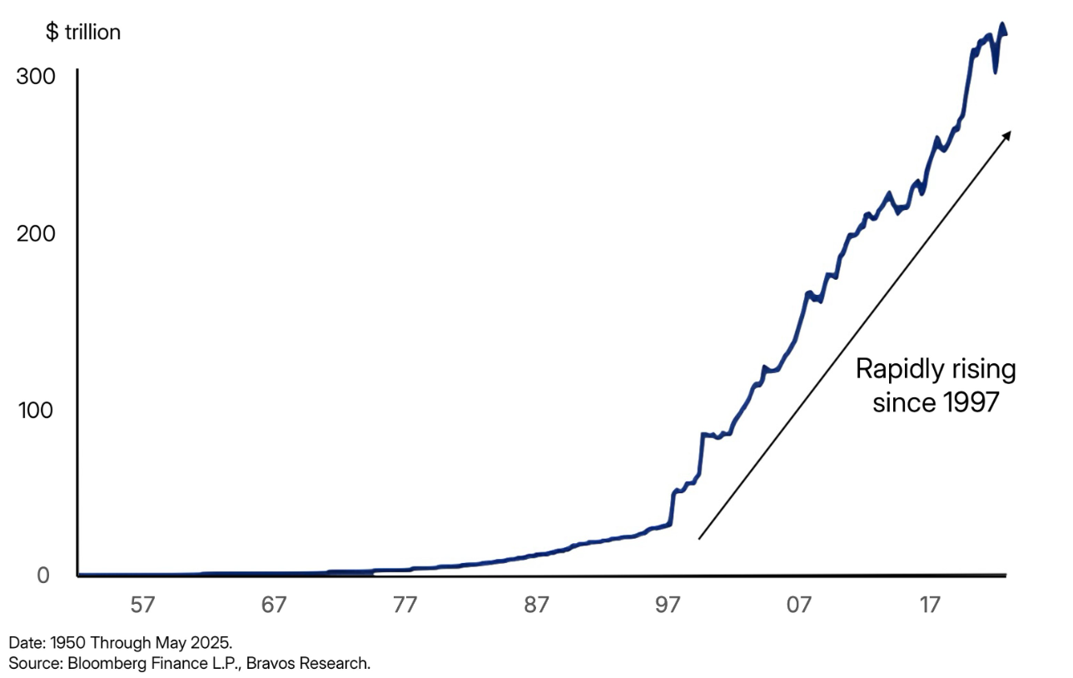
The starting point
Broken money… because of broken politics

Slide 6
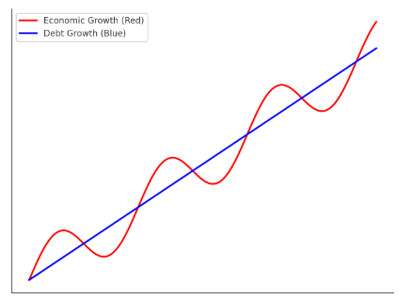
There’s math behind history
The capitalization of interest on debt structurally grows at a faster rate than the growth rate of the economy; in detail, interests (and therefore debt) grow exponentially while the economy grows at an "S" pace, therefore more slowly. A couple of examples:
Being part of a civilization that has its roots in Christianity, we are all familiar with the “Our Father prayer”; the common belief is that prayer refers only to the theme of forgiveness of sins but in the time of Jesus there were wars over debts (“Rimetti a noi i nostri debiti come noi li rimettiamo ai nostri debitori” / “forgive us our debts as we forgive our debtors”)
You shall also count to yourself seven Shabbat years: seven times seven years; these seven Shabbat years will make for you a period of forty-nine years. On the tenth day of the seventh month, you will blow the trumpet; on the Day of Atonement, you will sound the trumpet throughout the land. And ye shall hallow the fiftieth year and proclaim liberty in the land to all the inhabitants thereof. It will be a jubilee for you; each of you will return to his property, and each of you will return to his family. The fiftieth year will be a jubilee for you; you shall not sow or reap what grows spontaneously, and you shall not harvest the unpruned vines. For it is the jubilee; it will be sacred to you. You will eat the produce that the fields give you. In this year of the jubilee everyone will return to their properties. » (Leviticus 25:10-13)
There’s math behind history…
You default on debt
Debt forgiveness can be:
You default on the currency

Slide 7
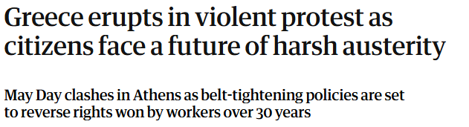
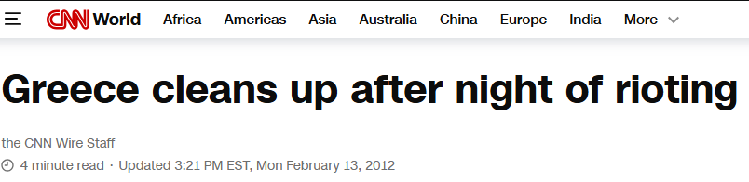
Debt forgiveness: why default on debt is not
an option
Debt forgiveness is a political decision not an economical outcome. Politicians are in charge, not macroeconomists.

Slide 8
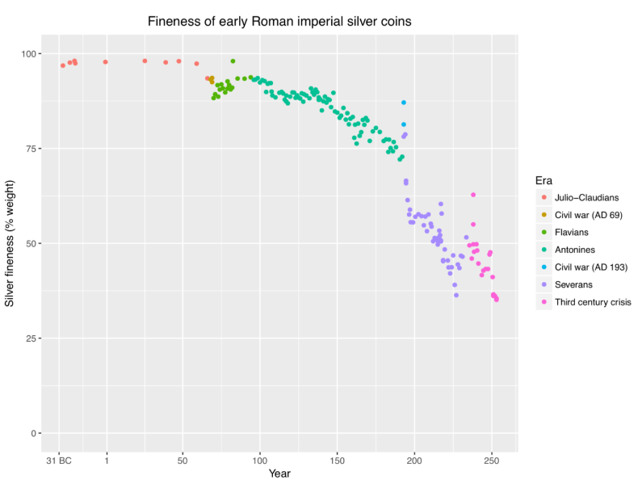
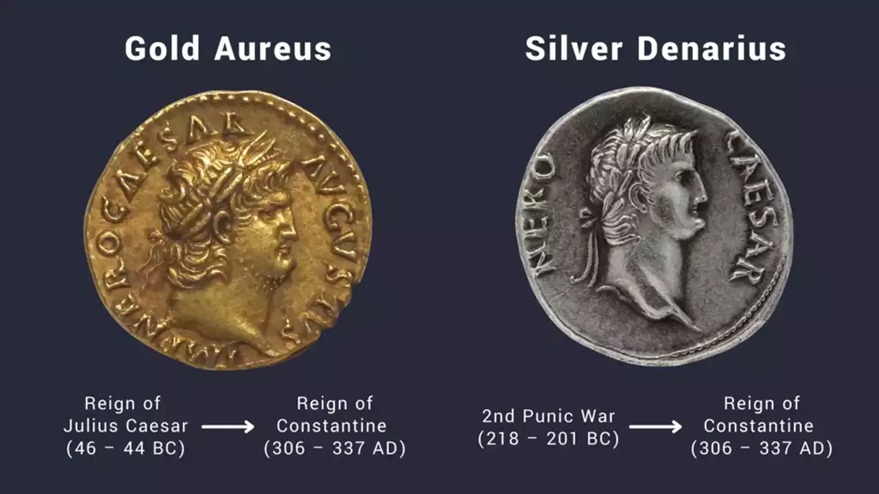
Debt forgiveness: the default of the currency…
It’s not the first time…
The debasement of Roman currency, particularly the silver denarius, occurred gradually over time as the Roman government altered both the size and silver content of the coin.
Starting from AD 64, the Romans continuously debased their silver coins until, by the end of the 3rd century, hardly any silver was left.

Slide 9
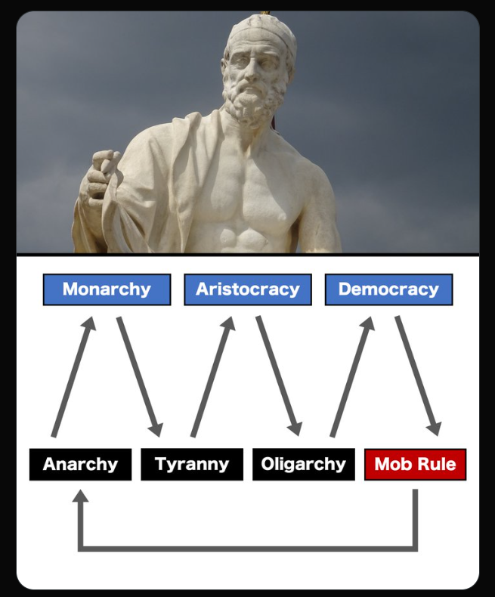
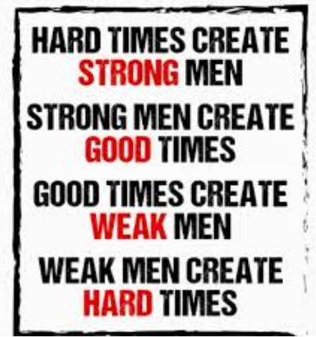
Human cyclicality
The transition from weak money to sound money is part of the natural cyclicality of history, as highlighted also by Polybius and Michael Hopf

Slide 10
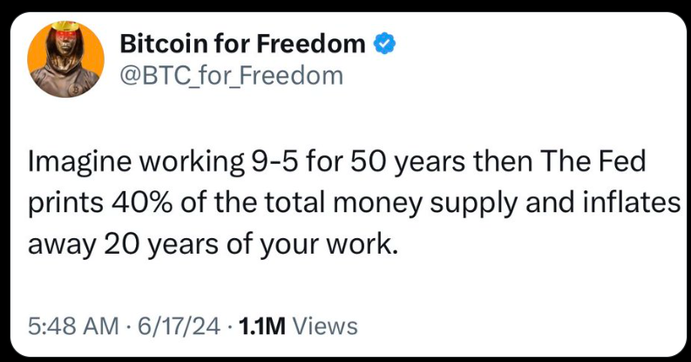
The world we live in: no need to comment…
But then COVID-19 happened. Central banks ramped up bond purchases to ensure liquidity. A financial crisis was averted, but the surge of money supply during this period was massive. Since the COVID crisis, money supply has grown by 40% in the U.S., 22% in the U.K. and 20% in the Eurozone

Slide 11
Macro & Geopolitics

Slide 12
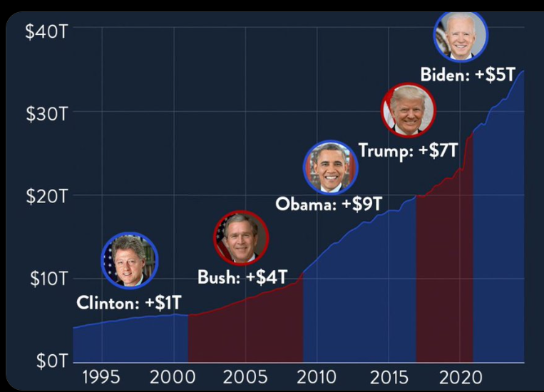
Debt is a bipartisan luggage
The chart shows the steady rise of U.S. national debt from 1995 to the present. Key events like the 2008 financial crisis and the COVID-19 pandemic drove sharp increases, with debt growing under every administration.
The overall message: national debt has risen consistently over the past three decades, regardless of whether Democrats or Republicans were in power

Slide 13
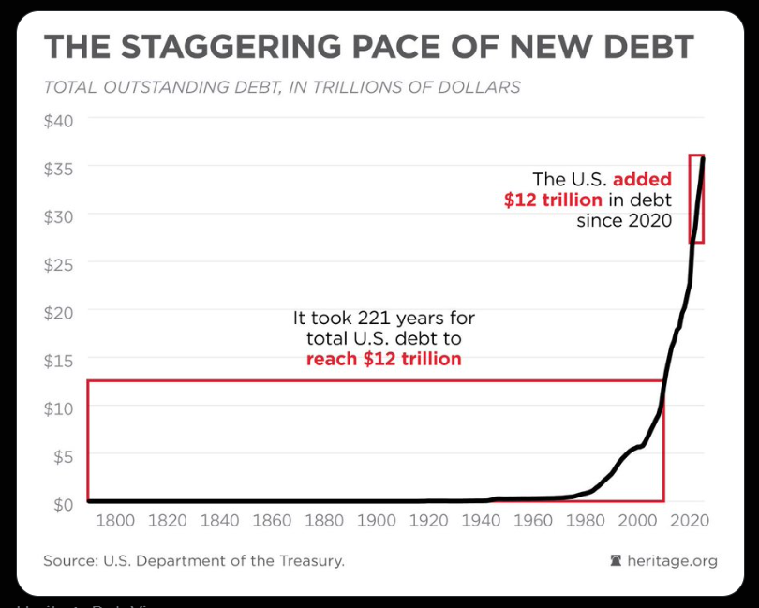
BRICS are Macro aware (part 1)…
The chart illustrates the rapid acceleration of U.S. national debt. It highlights that it took 221 years, from the nation's founding to 2020, to accumulate $12 trillion in debt. However, in just four years since 2020, the U.S. added another $12 trillion. This stark comparison underscores the unprecedented pace of recent borrowing, driven by factors such as pandemic-related spending, economic stimulus packages, and rising interest costs. The visualization emphasizes the exponential growth in debt, raising concerns about its sustainability and future economic implications.

Slide 14
BRICS are Macro aware (part 2)…
The dollar has experienced significant debasement over recent decades, a trend that has been accelerating since the implementation of Modern Monetary Theory (MMT) by the U.S. government. The chart highlights that since 1999, the U.S. dollar's purchasing power has declined by about 80%, attributed to the explosive growth in the money supply (M2) from $4.7 trillion to $21.2 trillion​.

Slide 15
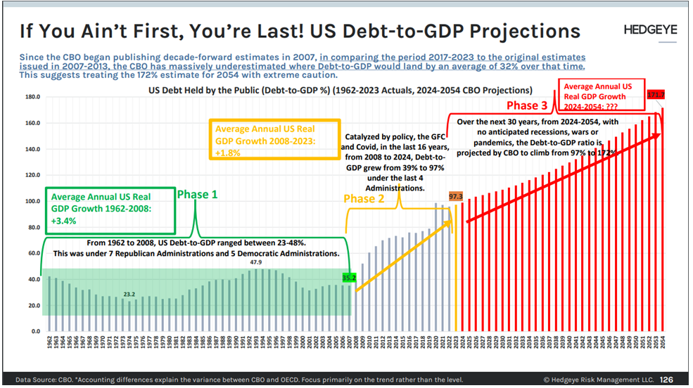
BRICS are Macro aware (part 3)…
Phase 1 (1962-2008)
Average real GDP growth +3.4%
Range US Debt-to-GDP 23-48%
Phase 2 (2008-2023)
Average real GDP growth +1.8%
Range US Debt-to-GDP 39-97%
Phase 3 (2024-2054)
Assuming no recession
Range US Debt-to-GDP 97-172%
Notice that Congressional Budget Office (CBO) started to publish decade-forward estimates in 2007. Comparing the period 2017-2023 to the original estimates issued in 2007-2013, the CBO underestimated the ratio by an average of 32%

Slide 16
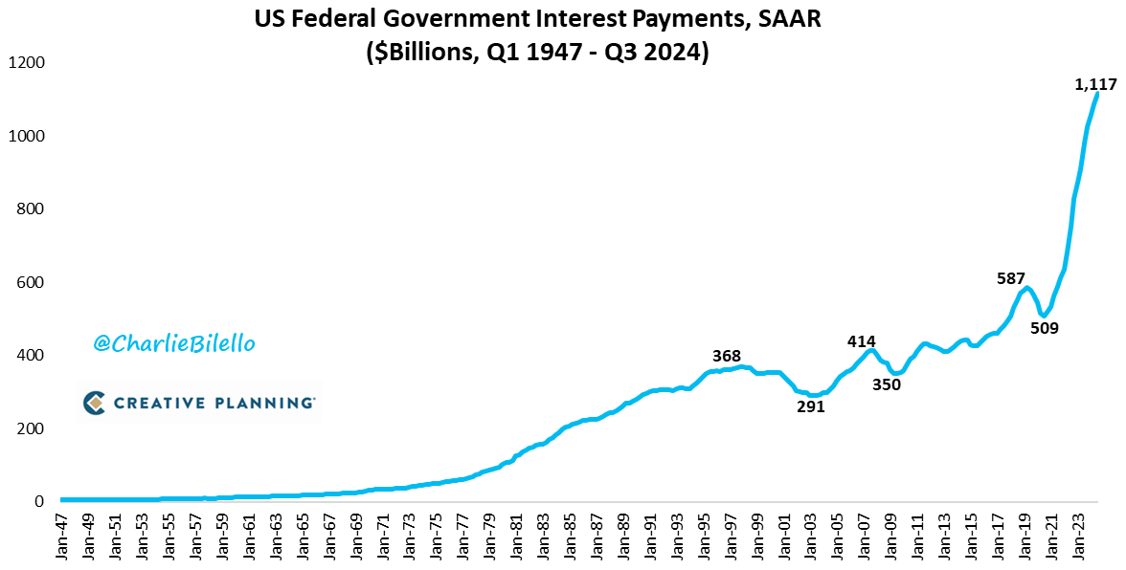
BRICS are Macro aware (part 4)…
The interest payments on US National Debt have spiked to a record $1.1 trillion annual rate, increasing 120% over the past 4 years.

Slide 17
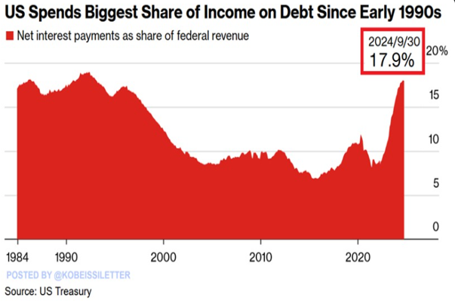
BRICS are Macro aware (part 5)…
United States is currently spending 17.9% of its revenue on interest payments, the largest share in more than 30 years

Slide 18
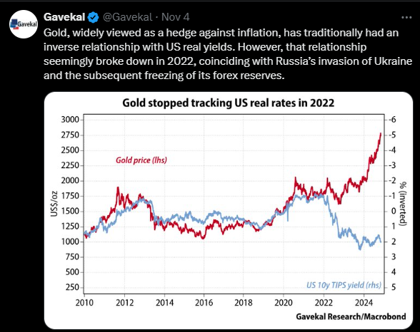
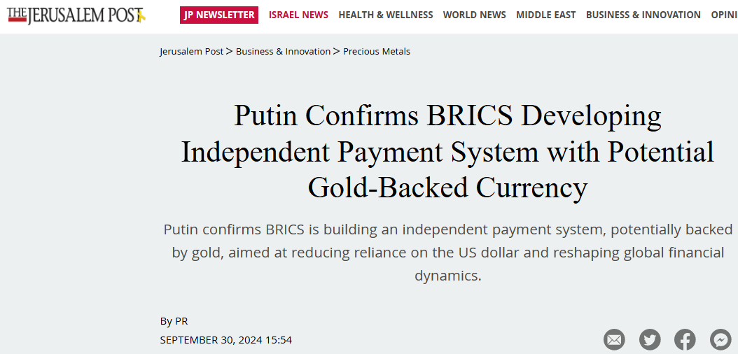
The War in Ukraine as catalyst for the take-off of gold

Slide 19
Finance and scarcity

Slide 20
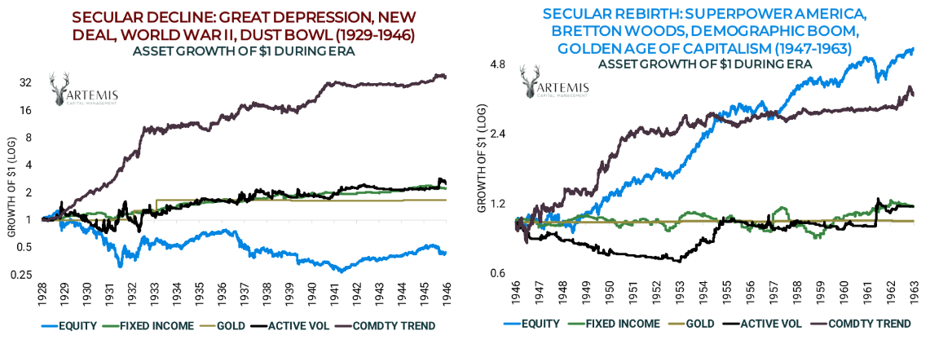
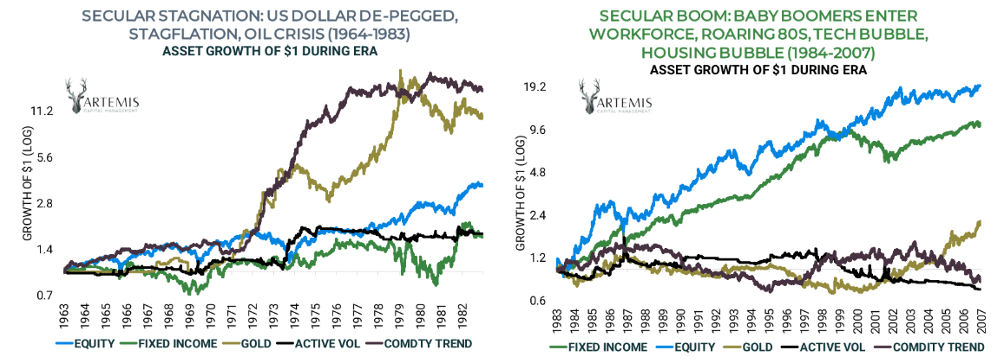
Always History first… this time of financial
markets
Debasement
Monetary and nominal asset depreciation is the most neglected risk in investments as it requires a long-term perspective
Taking a 100-year horizon as reference, equities haven’t always been the best-performing asset class (e.g. 1928-1946)

Slide 21
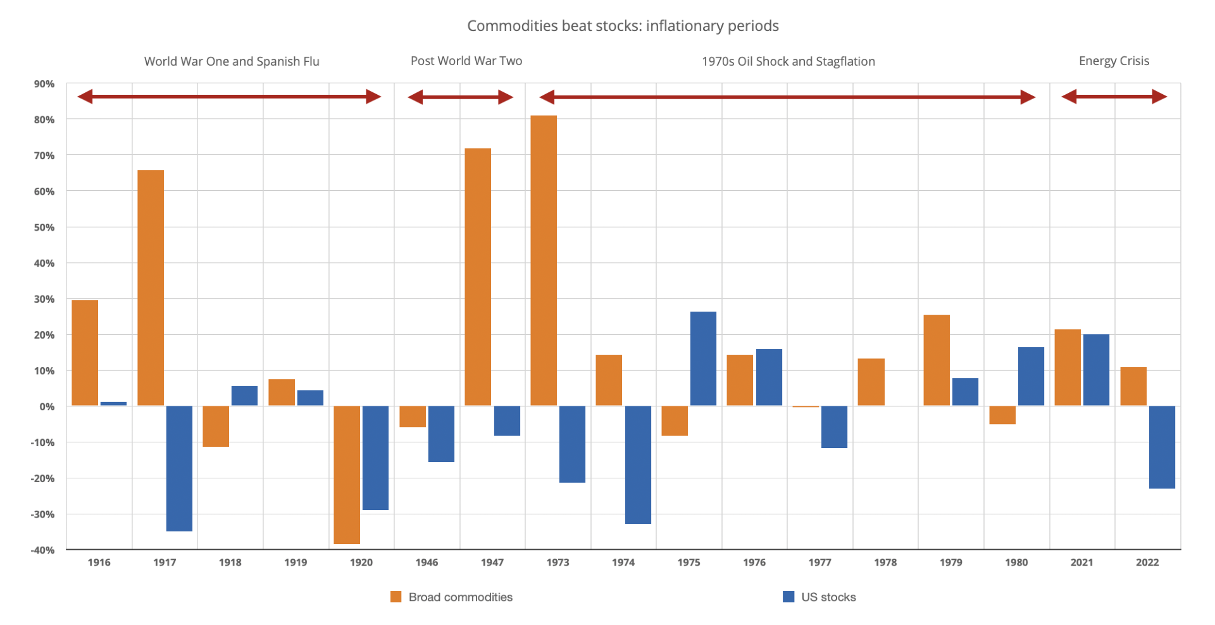
Historical returns of equities and commodities
in periods of inflation
Commodities tend to outperform stocks in periods of inflation, which often coincide with downward phases of the stock market, as can be seen from the graph on the left (the performance of stocks is in blue, that of commodities is in orange):
World War I and Spanish Flu (1916 - 1920)
Post World War II (1946-1947)
Oil shock and stagflation of the 1970s (1973–1980)
Energy crisis (2021-2022)
The chart on the left shows how commodities have performed better than stocks in 12 out of 17 years when the inflation rate was high

Slide 22
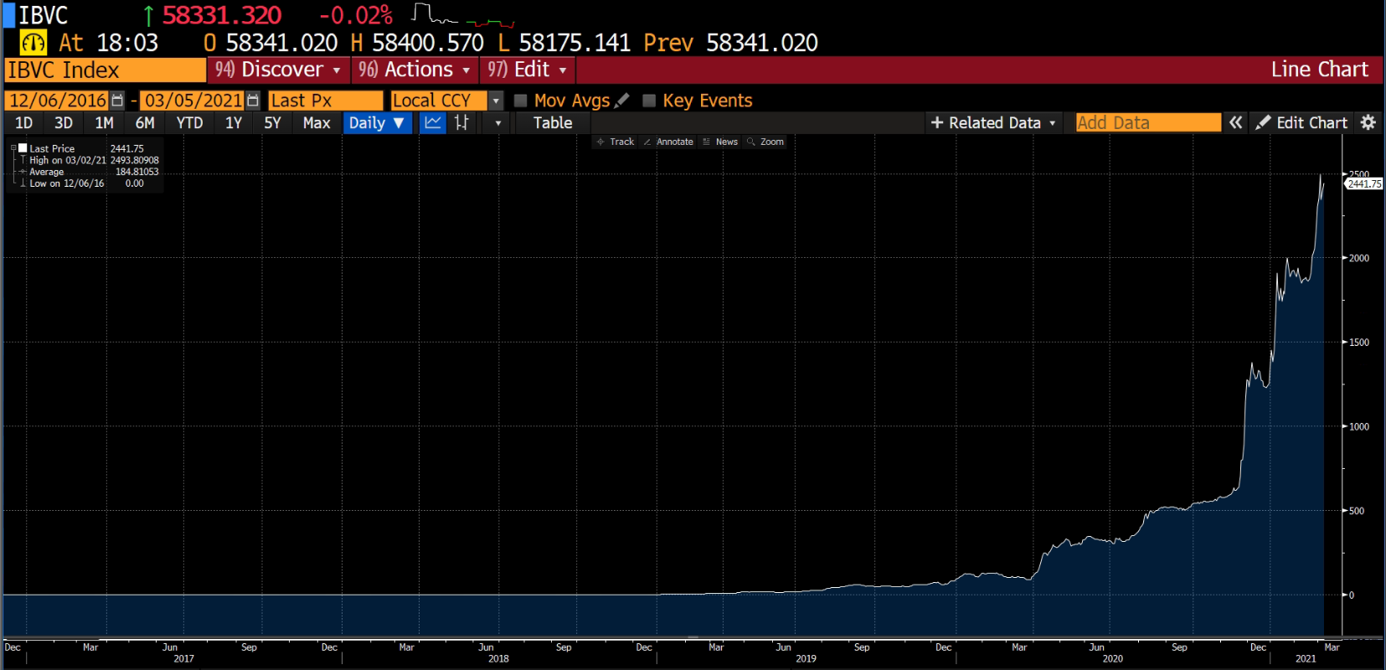
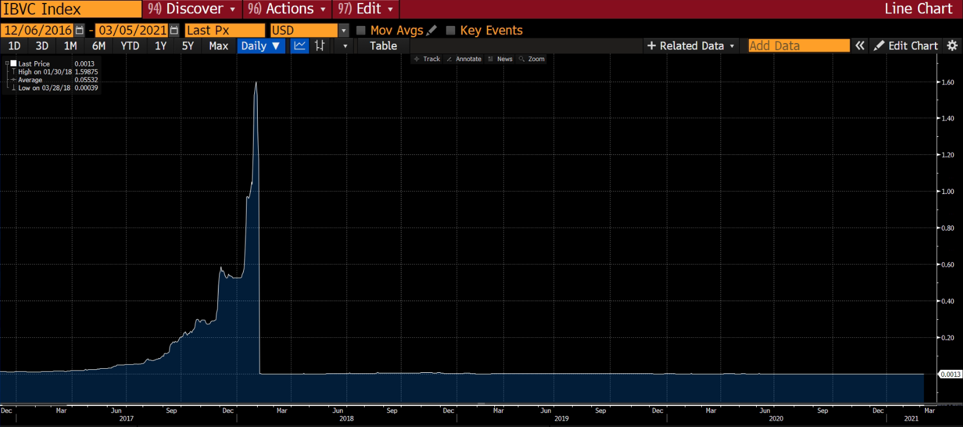
G8 and the risk of #Amerizuela: first stop
Caracas…
Emerging markets have historically seen their currencies devalue against the dollar... but what to do if it’s the dollar that devalues? Then: can the world reference currency devalue?
In Caracas, the National Equity Index grows in Bolivares terms, but when you calculate it in USd terms, it’s flat…

Slide 23
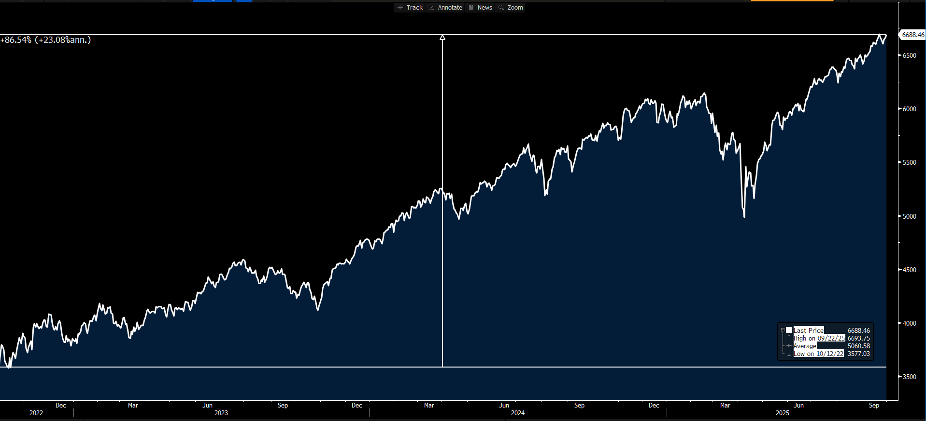
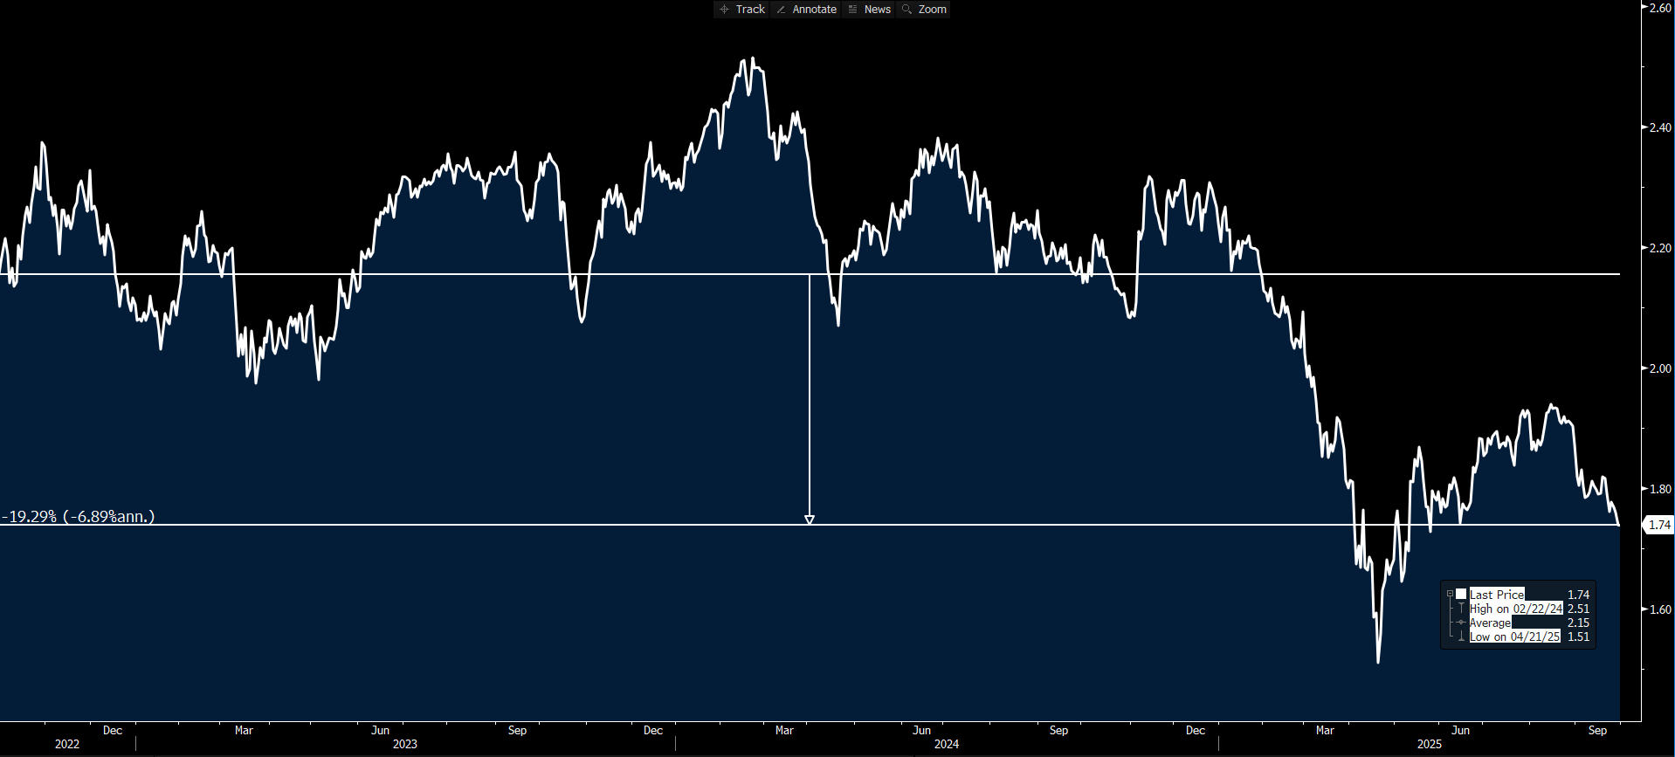
G8 and the risk of #Amerizuela: second stop
New York…
SP500 IN USD TERMS
3y PERF: +86%
The same dynamic happened in the last 3 years for US Equities:
S&P 500 is up 66% priced in USD
S&P 500 is down 10% if we price it in Gold
SP500 IN GOLD TERMS
3y PERF: -19%

Slide 24
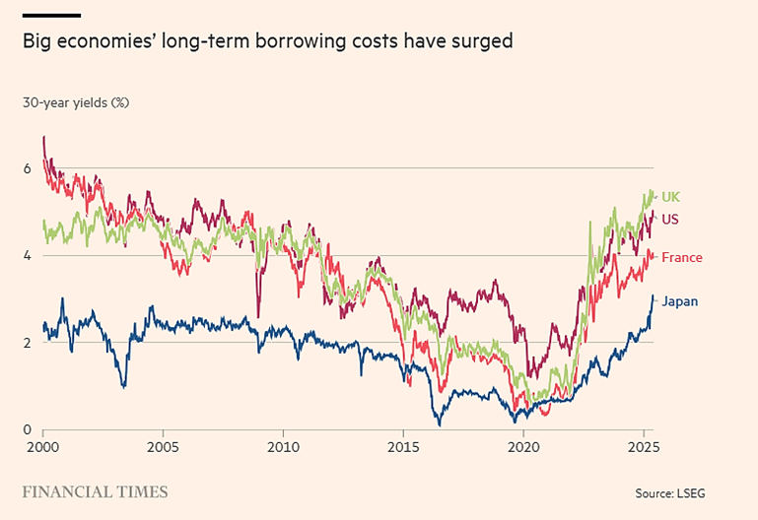
Early signs of «fiscal dominance» across G8
A clear debt problem that must be framed on a global scale
While central banks exert a strong influence on short-term rates longer term yields are determined by market dynamics which have led to 30-yield rates reach the highest levels in almost two decades
"Fiscal Dominance“ means governments influence monetary policy to the detriment of the independence of the central bank.
History teaches us that any attempt at forcefully influencing longer-term rates through e.g. QE or capping LT bond issuance, precipitates currency devaluation

Slide 25
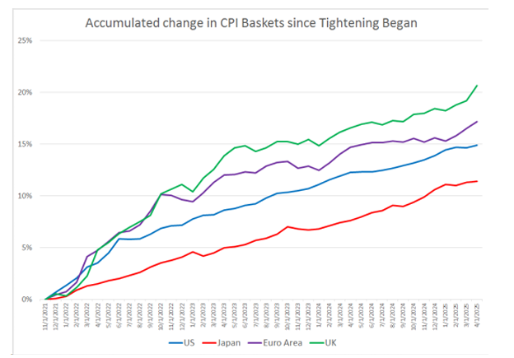
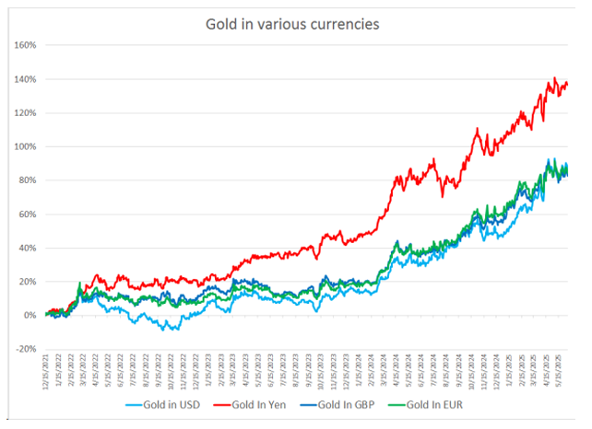
Currency markets weakness
Currency weakness, measured in various ways, has been broad-based despite central banks engaging in tightening post-Covid.
The rise in the price of the consumption basket has slowed but has accumulated and is still running above YoY target of 2.7% vs 2%
Against Gold, the four major currencies are depreciating and that depreciation has become more rapid since easing began

Slide 26
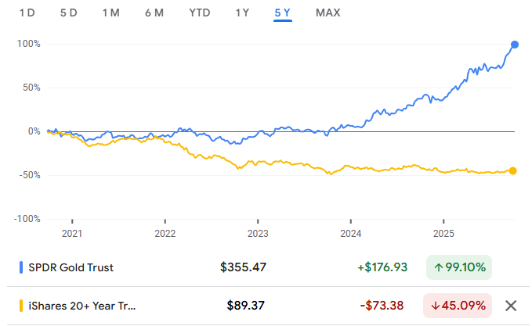
So what to do ? And what NOT to do…
Understanding what to do can be difficult, while it is very easy to understand what NOT to do...
FORGET ABOUT NOMINAL ASSETS AS A CAPITAL PRESERVATION INSTRUMENT!

Slide 27
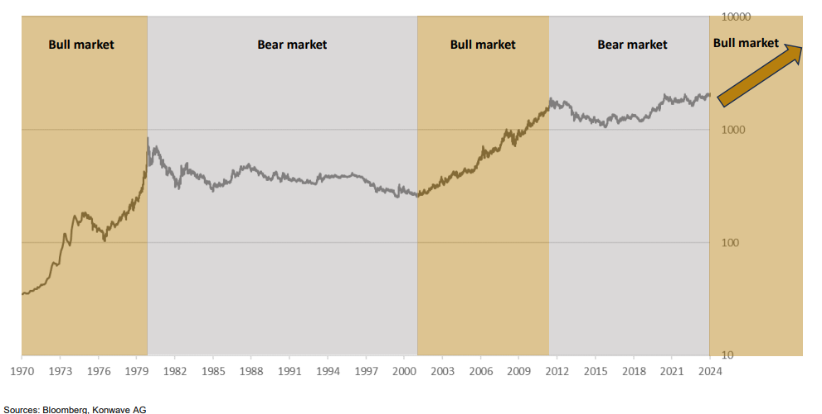
Gold and the fear of being late… (part 1)
The chart shows alternating bull and bear markets for gold from 1970 to 2024. Bull markets highlight periods of rising prices, such as the late 1970s, early 2000s, and post-2020, while bear markets show stagnation or declines, like in the 1980s-1990s and 2013-2018. The evidence suggests a new bull market is emerging, reflecting renewed optimism in gold's performance amid economic and geopolitical uncertainties.

Slide 28
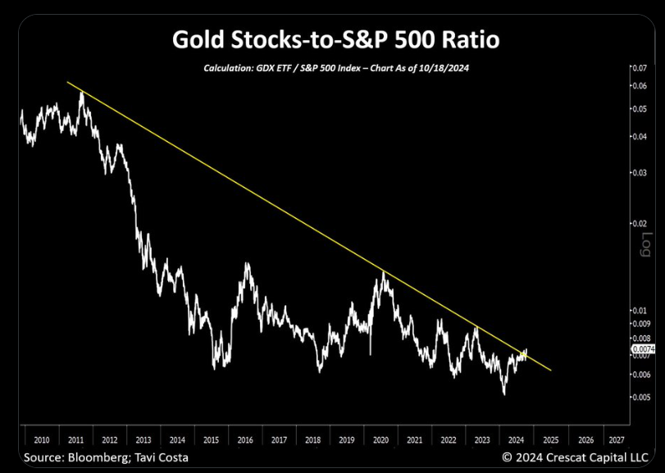
Gold and the fear of being late… (part 2)
This chart illustrates the Gold Stocks-to-S&P 500 ratio from 2010 to 2024. The downward yellow trendline highlights the long-term underperformance of gold stocks relative to the S&P 500 since 2011. However, recent movements in 2024 indicate a potential breakout above the trendline, signaling a possible shift in momentum.

Slide 29
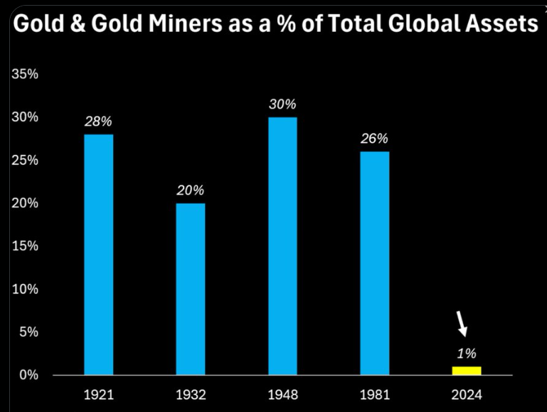
Gold and the fear of being late… (part 3)
This chart shows the historical share of gold and gold miners as a percentage of total global assets, highlighting a significant decline over the past century. In 1921, gold and gold miners accounted for 28% of global assets, peaking at 30% in 1948, and gradually declining to just 1% in 2024. With increasing focus on diversification and safe-haven assets, gold miners could benefit from a potential reallocation of global capital

Slide 30
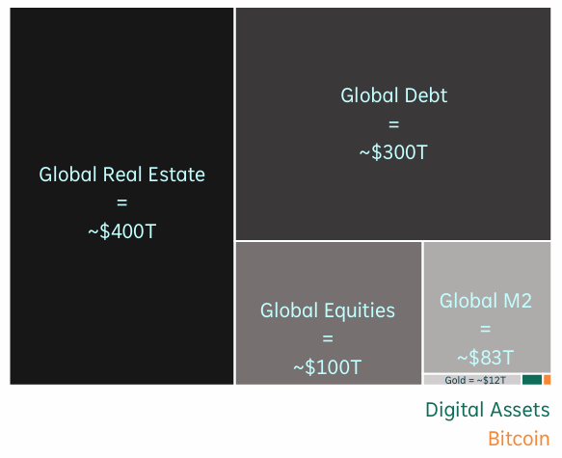
Bitcoin is scarcer than gold…
Since the summer of 2020, Bitcoin has overperformed every other asset class showing almost double the annualized gains of the Magnificent 7.
Bitcoin is scarcer than gold because its total supply is capped at 21 million coins, making it a finite digital asset, while gold annual inflation has averaged 2% over the last 10 years
20T
$3.5 Tn

